Slide 1
Effects of ligand binding to ACE2 and ___
Jonathan Borowsky, Asa Kalish, and Yisheng Zheng

Slide 2
Questions
What structural factors contribute to the thermodynamics of ligand binding to ACE2?
Crystal structures provide some insight into enthalpic and hydrophobic effects
Entropic effects on protein not captured by crystal structure
MD simulations provide insight into dynamics
We compared ligand-free (apo) and ligand-bound (holo) simulations
Flexibility of ligand-binding residues as proxy for entropic effects

Slide 3
Hypothesis
The presence of the ligand introduces new steric constraints
Protein-ligand interactions such as H-bonds create potential wells which disfavor motion
Holo structure is more compact
Ligand-binding residues are less flexible in holo structures compared with apo structures.

Slide 4
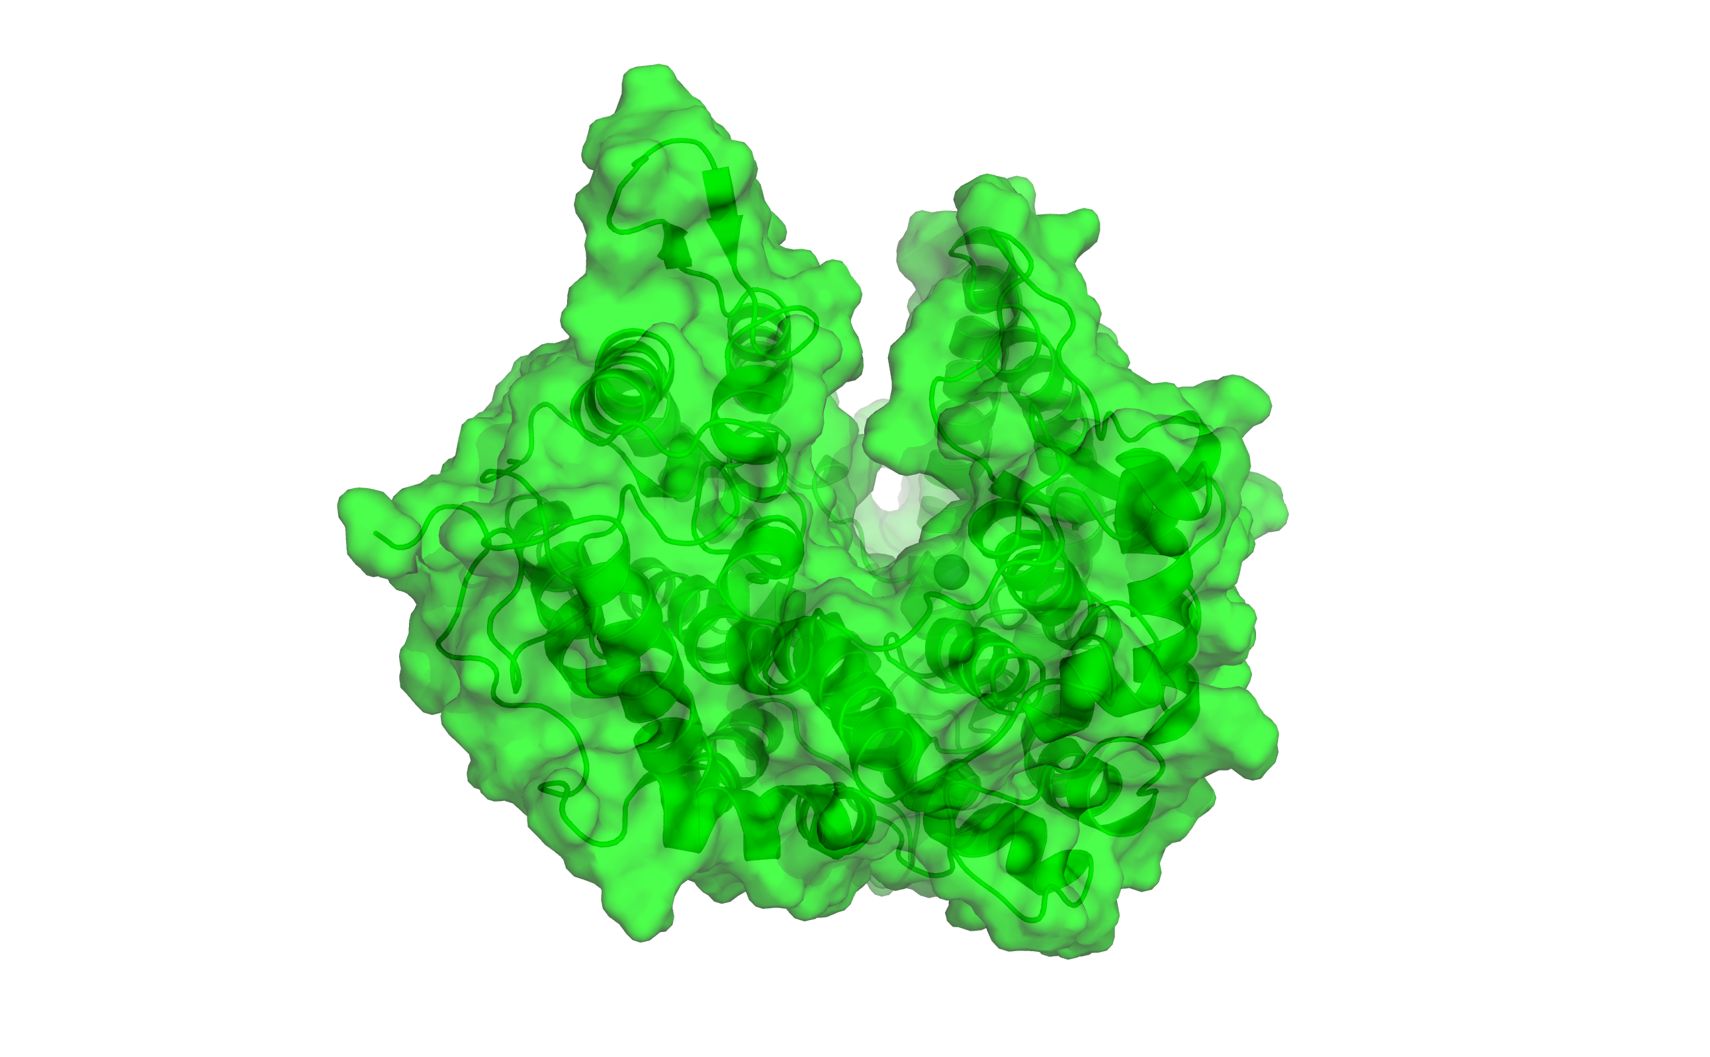
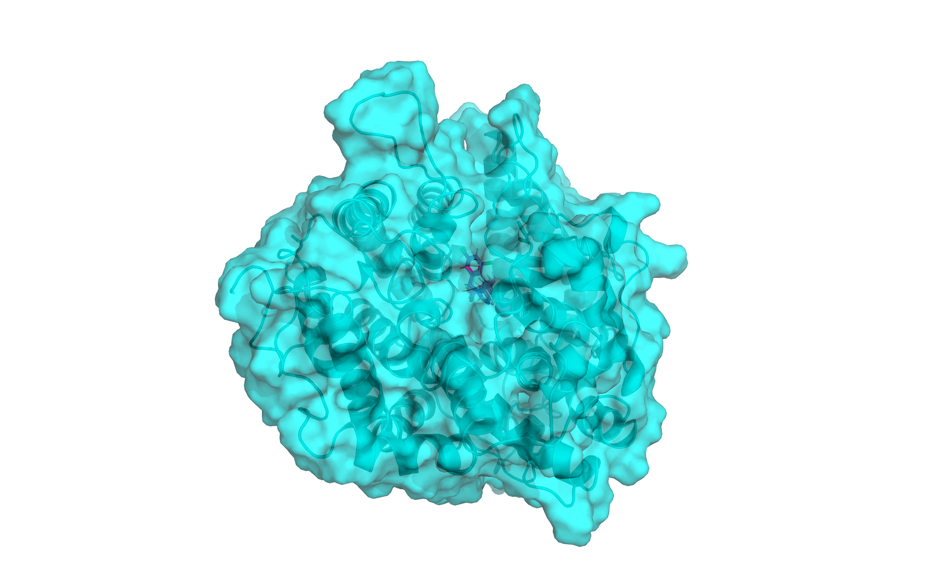
Conformational change upon ligand binding
Apo (ligand-free)
Holo (ligand-bound)

Slide 5
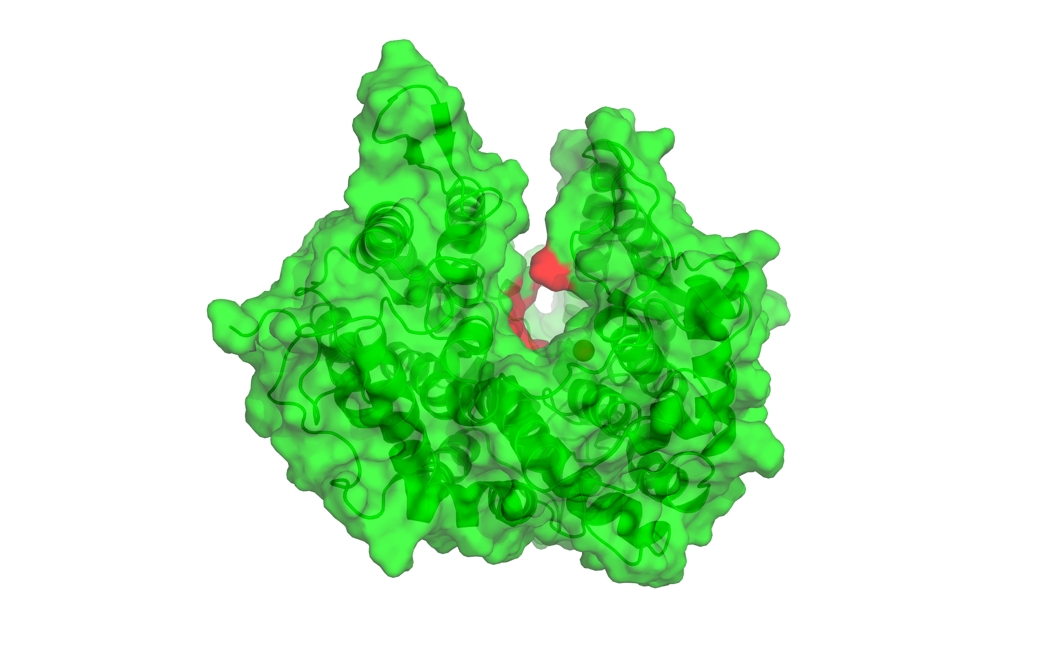

Conformational change upon ligand binding
Apo (ligand-free)
Holo (ligand-bound)

Slide 6
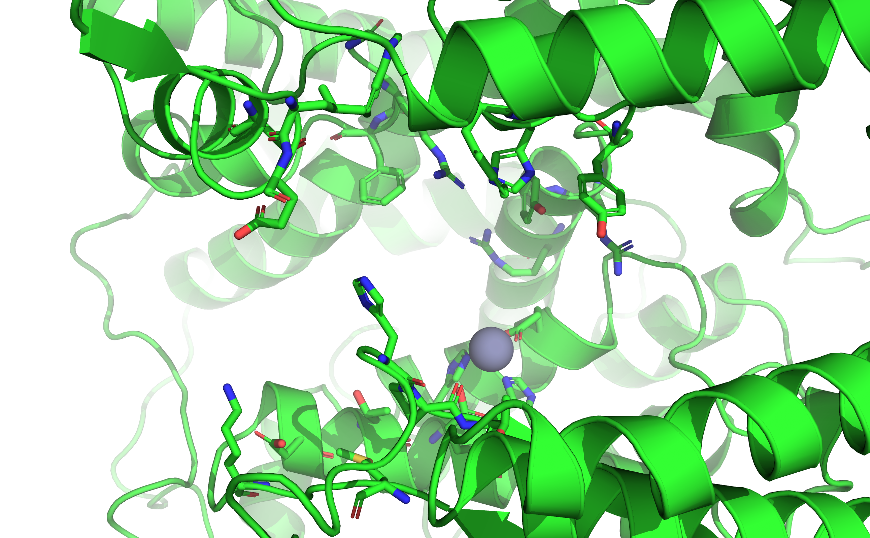
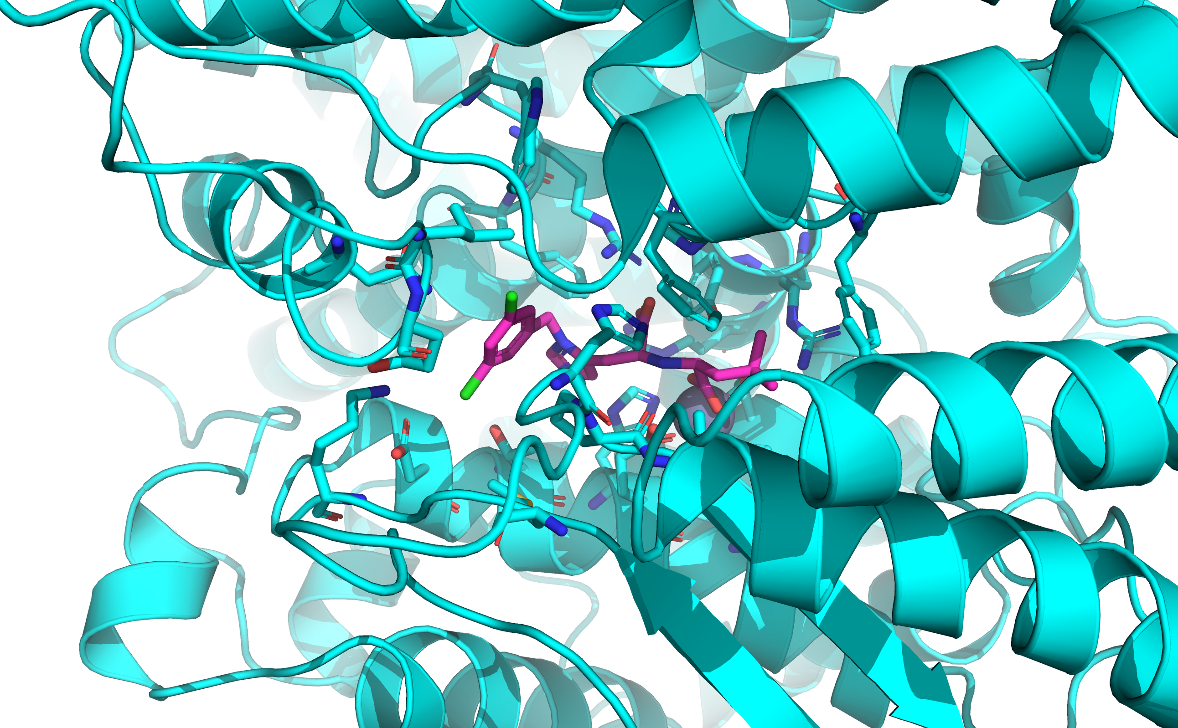
Ligand binding site
Ligand binding residues:
Residues with heavy atoms within 5A of the ligand in the holo simulation starting structure

Slide 7
RMSF
Root mean square fluctuation
Align each simulation frame
Calculate mean position of each atom over the course of simulation
Calculate square displacement from mean in each frame
Average the square displacements and take the square root
Gives an estimate of how flexible atoms are

Slide 8
Testing the hypothesis
Hypothesis in terms of RMSF:
Atoms in ligand-binding residues have lower RMSFs in holo structures compared with apo structures.
Notes:
To rephrase the hypothesis in terms of RMSF

Slide 9
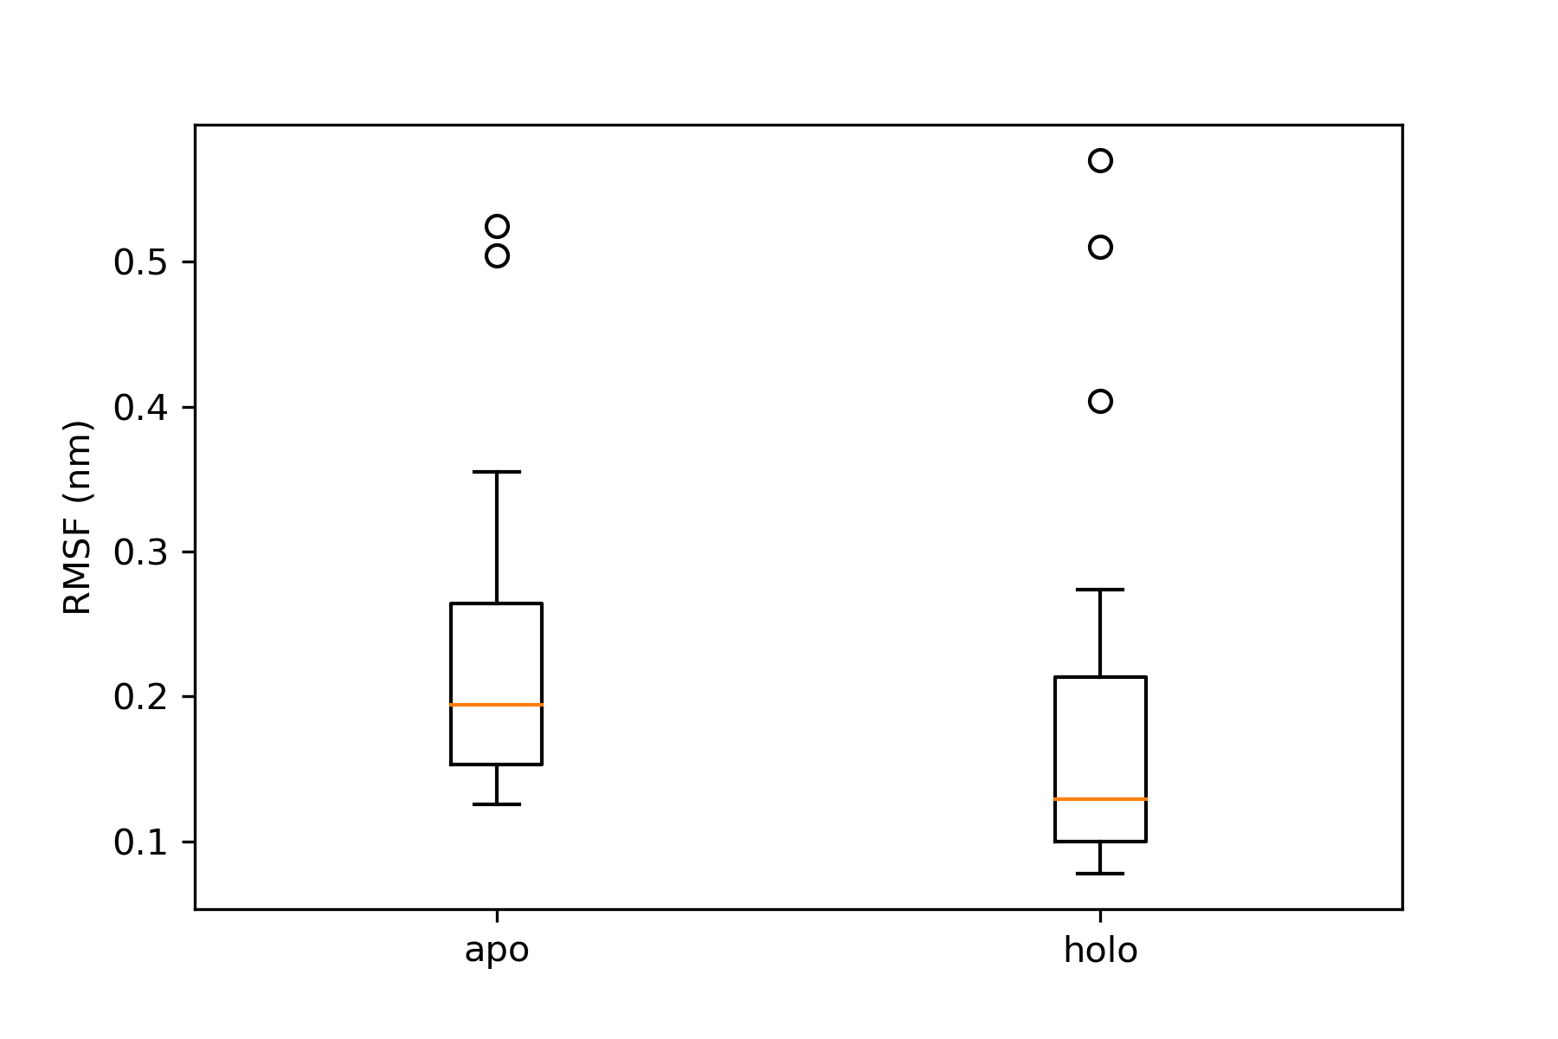
Results: ligand-lining residue RMSF
23 ligand-lining residues*
Difference is statistically insignificant at alpha = 0.05
*RMSFs were averaged across the atoms in each residue. Counting each atom individually is wrong because they don’t all move independently and thus aren’t independent observations. A more advanced approach might count rotatable bonds
The data do not reject the null hypothesis of equal RMSF
Notes:
Question for audience: What would independent observations be in this case? ←→ how many observations do I have?

Slide 10
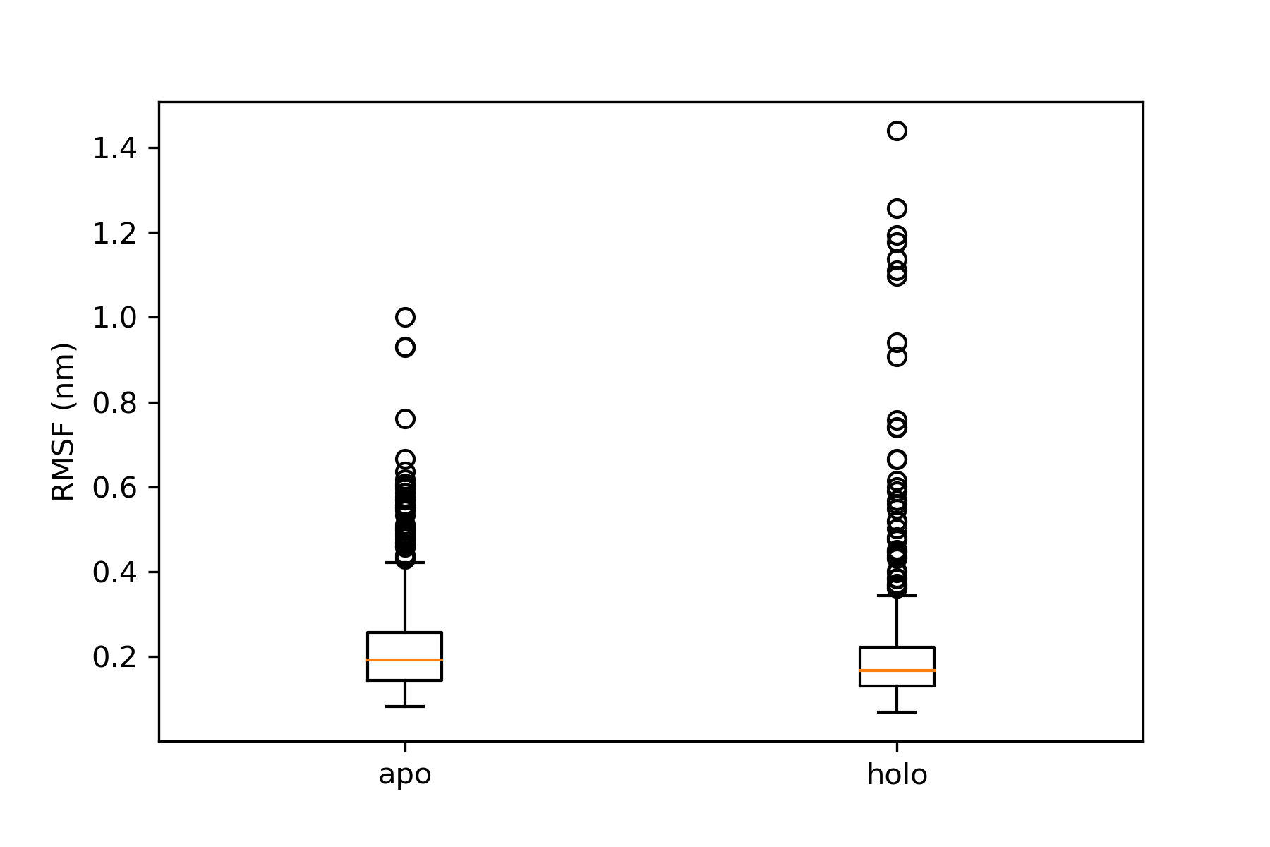
Comparison of non-ligand-lining residues
577 ligand-lining residues*
Difference is statistically significant at alpha = 0.05
*many of these are bound into alpha-helices, so the actual number of residues which move independently [with a low energy barrier] is lower
Very small difference in RMSF
Actual significance unclear due to questions of observation independence
Notes:
Question for audience: What would independent observations be in this case? ←→ how many observations do I have?
Greater flexibility of non-ligand-lining residues is inconsistent with published work analyzing PDB structure flexibility based on b-factors

